Slide 1
Intro to Openvas
CW3 JAMES HONEYCUTT

Slide 2
About_Honeycutt
24 Years of service (21 in IT/Cyber)
Former PEC SysAdmin
Now team expert for Windows and PowerShell
PowerShell enthusiast

Slide 3
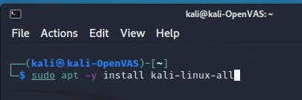
Notes:
Attempted install of kali-linux-core
OpenVas was not part of the tool list
Attempted to install kali-linux-large

Slide 4
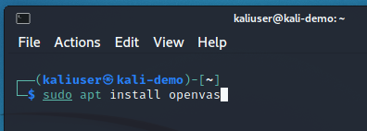

Slide 5
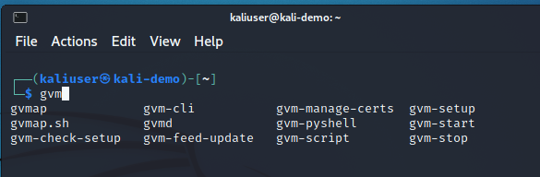

Slide 6
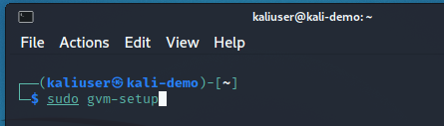

Slide 7
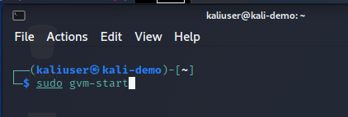

Slide 8
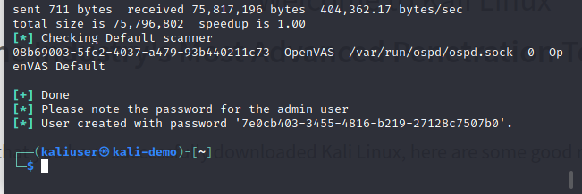

Slide 9
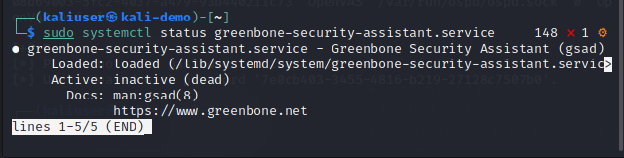

Slide 10
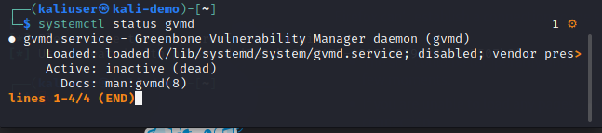

Slide 11
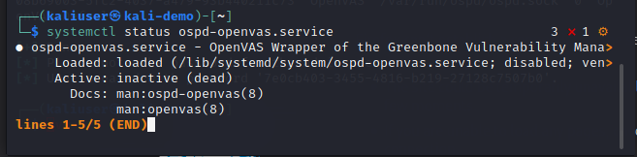

Slide 12
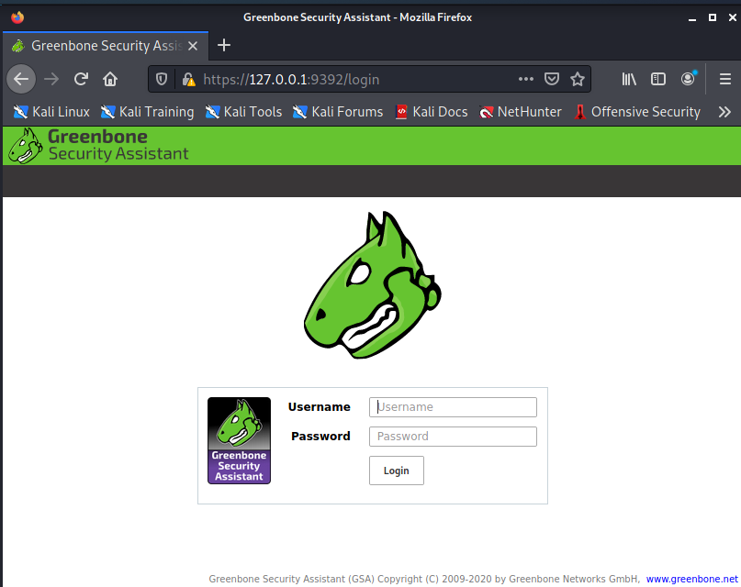

Slide 13
